Slide 1
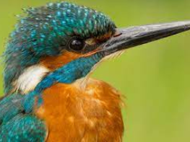
Pentecost Term 2 St Norbert’s Catholic Primary Academy
Hello! Year 4
Welcome to Pentecost 2
Myself and Mrs Beavis are so happy to welcome you all back to our final term together.
We hope you all had a lovely half term and are ready for some exciting learning in the weeks to come.
Don’t forget to keep practicing your times tables for our weekly Star badge challenge.
Remember to keep practicing Our year 3 4 spellings each week ready for our spelling assessment at the end of term.
Remember to log on and practice using Times tables Rock Stars.
This term we have got some fantastic learning for you to enjoy.
Science is all about living things and their habitats. We will be looking at classification, food chains and habitats.
History is all about the Romans. We will be learning about their lives, gods and inventions before our Visit to Flag Fen later on in the term.
RE is all about Dialogue and encounter. Children will be learning about the life of St Paul, Catholic traditions, rites and virtues.
Our DT focus this term is cushion making. Children will be looking at natural and symmetrical designs, complementary and contrasting colours and a range of stiches and applique.
French is about European music.
PE is focusing on run, jump throw and strike react raally.
Most importantly don’t forget to practice your spelling and times tables.
English is about writing a non chronological report and a mystery story
Maths is focused around time and then we will be looking at properties of shape, position and direction.
Did you know….
There are some amazing maths games you can play online which are all based around the national curriculum.
Follow the links to find out more…
Adaptedmind.com
https://www.teachwire.net/news/maths-games-ks2
https://home.oxfordowl.co.uk/kids-activities/fun-maths-games-and-activities/
http://www.crickweb.co.uk/ks2numeracy.html

